Slide 1
MOVIEMAKING
MERIT BADGE

Slide 2
What is Art?
“the expression or application of human creative skill and imagination, typically in a visual form such as painting or sculpture, producing works to be appreciated primarily for their beauty or emotional power.”
the various branches of creative activity, such as painting, music, literature, and dance.
https://www.google.com/search?q=what+is+art&oq=What+is+art&aqs=chrome.0.0l6.2149j0j8&sourceid=chrome&ie=UTF-8

Slide 3
What is Moviemaking?
“A way to tell stories visually through the art and science of motion picture photography.” (p. 7., MB Book.)
It combines two Arts:
  Photography (Taking a picture of someone or something and recording it on film.
  Theatre (Which combines many art forms to tell a story visually to an audience through a play.)
And adds one more art: Motion Picture or
  The art of making those Photographs appear to move.

Slide 4
How are Movies and Theatre Similar?
Play
Script or Screenplay
Actors
Set
Lighting
Sound
Costumes
Props
Makeup
Special Effects
Audience
Director
Producer
Production Team
Others?

Slide 5
How are Movies and Theatre Different?
MOVIES THEATRE
Recorded in time. Live
No audience during shoot Audience (Live). Interacts wActors. Exception: Television Applause, laughter, Break “Fourth Wall”
Director frames the picture. Audience sees whole stage. Tableaux. Arrangement of frames central.
Movie stays the same. Shows change: Different productions.
Appeals to wider audience Limited audience: One theatre. Wide distribution of Film.
Tickets cheaper. Tickets more expensive.

Slide 6
What skills does one need for making movies?
  Photography
  Strorytelling
  Imagination
  The ability to communicate verbally and through non-verbal means.
  The ability to draw the audience in
    Empathy
    Suspension of Disbelief
  Acting
  Directing
  Writing
  Techincal knowledge?

Slide 7
Science of Moviemaking
Filmstrip: Strip of Movie Film
  A series of still photos recorded in a camera at a speed of 24 frames/second
Persistance of Vision:
  Illusion that what the frames of still photographs being projected on a screen at 24 frames/second>
  The images passing before your eyes appears to be one image that is in motion.
  Eg. The same thing happens with a flip book.
  https://www.youtube.com/watch?v=ud8dSDy5lB4
  https://www.youtube.com/watch?v=7n2YF7mfP5s

Slide 8
Edward Muybridge (1830-1904)
CREDITED FOR INVENTING THE FIRST MOTION PICTURE ON FILM
HORSES GALLOP

Slide 9
Early Animation
Thaumatrope
  https://www.youtube.com/watch?v=i-hltO9ZR18
Phinakistoscope
  https://www.youtube.com/watch?v=FkoWioYrPtE
Zoetrope
  https://www.youtube.com/watch?v=3Iczb82zd6s
Flipbook
  https://www.youtube.com/watch?v=7K3aMdnCqXg

Slide 10
Birth of Cinema
Montage
Edwin Muybridge: Gallopping Horse. Credited with creating the First Ever Motion Picture.
First photographs mounted on a circular disk projected with a magnifying lens and light source onto a wall in a darkened room.
1882: Chronophotographic Gun used to record photos on a rotating glass plate.
1883: The glass plate became a roll of paper film.
1887: Celluloid Film first used.
https://www.youtube.com/watch?v=R0jm6j3s_uE
  https://www.youtube.com/watch?v=FYKZif9ooxs

Slide 11
Thomas Edison
Kinectograph: First Movie Projection Camera for celluloid. Holes in the film strip connected onto gears with teeth in them to pull it through the camera.
Created Kinectoscope, a coin opperating viewing device used in the first Arcades. (Disneyland’s Penny Arcade)
  https://www.youtube.com/watch?v=f__q9kiilLk
1893 CcreatedFirst Movie Studio: The Black Maria.o.
  https://www.lomography.com/magazine/224070-today-in-history-thomas-edisons-movie-studio-complete-1893
  New projector developed for longer films.
  By 1907: “a million people/day seeing movies in Nickelodians across the US.” (MBB)
    Cost 5 cents. Silent movies w/Piano accompanyist.

Slide 12
History of the Motion Picture
https://www.youtube.com/watch?v=7CDyjMouQyc

Slide 13
Elements of Moviemaking
Imagery: Manufactured images (The set, actor, lighting, costumes/makeup, special effects) that make up the scene in the picture. It’s all make-believe and set up by the director to tell a story…
Art of Storytelling: in play form with all the technical components of film: lighting, camera angles,
Audience Empathy/Willing Suspension of Disbelief: The willingness of the audience to think the make-believe world is real and to identity with and feel for the actors in the scene.
Cinematography: The way you film the story. It is the real art of photography mixed with story telling and the “theatre” of film.
  “Visual Story Telling”
  Down and Derby https://www.youtube.com/watch?v=gbwNUJK2UwA

Slide 14
Moviemaker’s Tools
Cameras
Quiet, synchronized-sound film cameras:
  Used for dialogue scenes
Loud, high-speed cameras
  Special effects
  Action
  500 frames/min. can take a one-second live action event and make it appear on screen for almost 21 seconds.
  https://www.youtube.com/watch?v=b-tL7GYh0Bw

Slide 15
Moviemaker’s Tools
Lenses
Prime Lens: Main lense. Offers one field of view
Zoom Lens: Ability to change the magnification of an image.
  Allows for close-ups
  Pull back
  Often can be used as a “variable prime lens” so that you don’t have to keep changing the lens for each shot.

Slide 16
Moviemaker’s Tools
Lenses
3 Parts of a Zoom Lens
  Focus: Adust the sharpness of an image.
  Zoom: Changes the focal length
    “The focal length of the lens is the distance between film and the optical center of the camera’s lens when it is focused. The larger the focal length, the greater the zoom.” (MBB) Expressed in millimieters (mm).
    https://www.youtube.com/watch?v=kZV1zz1zv_E
  Aperture: Controls the amount of light passing through the lens (or distance away from the subject.) (MBB)
  https://www.youtube.com/watch?v=Q5EOzQKEj9c

Slide 17
Moviemaker’s Tools
Lenses
Numbers used to describe lenses:
  F-Stop: the lower the f-stop, the wider the aperture, and the more light passes to the camera.
    Prime Lenses have wider apertures, helpful when shooting in low-light situations. (MBB)
  Millimeter: Used in the focal length of lens
    Low number: How wide the camera’s field of view is.
    High number: How long, tight, or telephoto and norrow the angle of view is. (MMB)
  Zoom Lens is adjustable.
  Zoom Range/Ratio: The range of magnification a lens can deliver. Divide large mm (telephoto)/small mm (wide angle)
  E.g. 100 mm telephoto: 10 mm wide angle = 100/10 or 10:1
  https://www.youtube.com/watch?v=y0fYcrQpHeM

Slide 18
Depth of Field
Focus of the area in front or behind the subject.
Full telephoto position:
  narrow depth of field
  Only a few inches of focus in front of and behind subject.
  Shallow depth of field. Like looking through pair of binoculars. Continuous need for adjustment of focus.
Wide Angle: Great (Deep)Depth of field where everything is in focus.

Slide 19
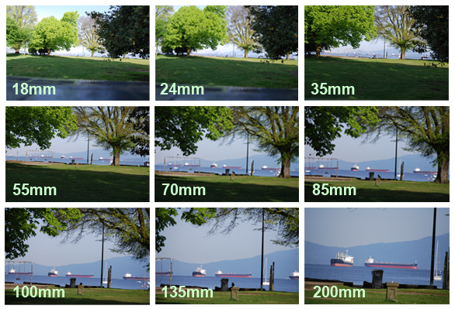
Focal Length

Slide 20
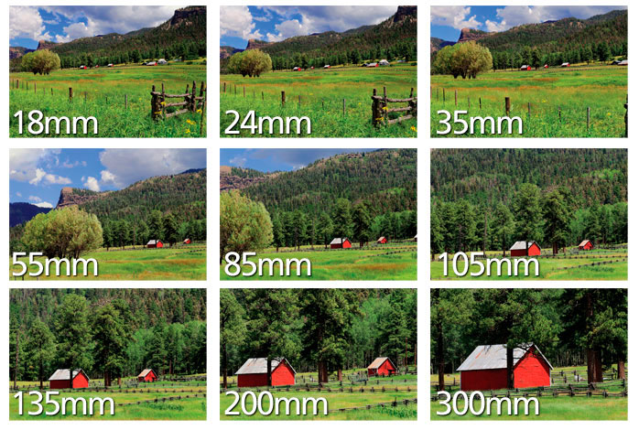
Focal Length

Slide 21
Film
35 mm: Major motion pictures.
  Big bulky cameras often loaded on cranes or special dollies.
  Less grainy than 16 mm.
  Substitute: High Definition Digital Video
16 mm: Lower budget, educational, independent produced films
  Lightweight
  Faster
  Less expensive to produce
  Substitute: Video tape/High Definition Videotape.
70mm
Flashback: 8 mm Home movies…

Slide 22
Digital Recording
Computer Software for editing.
Digital Video Camera: Option of editing through the lens while recording.
Digital Video Camera can be plugged into a computer w/cable and viewed on TV or saved on a hard drive.
Editing on computer and special effects added.
(MBB)

Slide 23
Lighting Equipment
Lot of options in the professional world.
  Spot lights placed around the set to illuminate it.
  Make subject visible
  Set moods.
  Set times.
  Cast shadows.
Use of natural light (outdoors) and filters.
Use of available indoor light (For this project).

Slide 24
Sound Equipment
Microphones
  Visible
    Often for dramatic effect.
    Can be distracting.
  Invisible (Out of camera shot)
  Lavalieres: Newscasts, Talk shows.
The mic on your own device is often okay. Make sure you do trials. You do not want to shoot your whole project only to find out you cannot hear the script.

Slide 25
Preproduction
IMPORTANT AS THE FINAL PRODUCT!
3 Catagories:
  Documentary: captures a news event or records information on particular topic with little to no fictionalization. (MBB)
    E.g. Animal Kingdom Stories
  Dramatic Story: Requires script, cast, rehearsal before shooting.
  Staged Demonstration: Procedure presented by an expert.
    Benefit from predetermined camera angles.

Slide 26
Preproduction
Write a Treatment:
  Explain/present your idea in a few paragraphs.
  Focus on the visual way you will tell the story.
  Helps give the focus of what you are going to do. Kind of like the Thesis of an essay.
Script: Typed pages
Storyboard: Rough sketches of camera angles.

Slide 27
Where to Shoot?
On location.
  Scout out the locations and pick them.
  Eg. Location for the Hobbit: New Zealand
  https://www.youtube.com/watch?v=HXSi6ulZ2rA
Movie Back Lot
  Versatile.
  Reusable
Sound Stage: Set
  Total control of environment.
  More specialized/Can be more Expensive.

Slide 28
Camera
Most Lenses on video cameras autofocusing.
F-stop
  Bright days: Use high number
    Large depth of field
    Need less light
  Gray days: Use lower number
    Limited depth of field
    Need more light
Tripod:
  Panning heads: allow smoother movement
  Adjustable legs
  Casters

Slide 29
Shooting
Record multiple takes
Need 10X more record time and storage than estimated time for your project.
Mics.
  Built-in or attached very sensitive. Pick up everything.
  Lavaliere
  Shotgun mic: Attached to a pole
  50’ extension cable
  Rent?

Slide 30
Shooting
Lighting
  Sun: Different times of days set different moods.
    Most dramatic: Sunrise/Sunset. Why?
  Use available indoor.
  Spotlights bounce off white sheets or walls and ceilings. Keep the subject from being too hot.
  Backlight: great for dramatic shots
  Three-quarter front light: most effective
Tools:
  Gaffer’s tape
  Insulated gloves to handle hot equipment.
  Patch a TV to camera.

Slide 31
Shooting
Continuity: The events must flow in logical order.
  Time of day
  Costume/Hair
  Location
  Set
  Anachronisms: Things out of place, like out of period prop/costume…
  Visual effects:
    Lap dissolve: the beginning of the next scene appears before the last scene disappears
    Fade in/Fade out.
    180-Degree Axis Rule
Rhythm: Development of story action
  Syntax: Harmonious arrangement of parts or elements
  One scene flows into the next.

Slide 32
Cinematic Elements
180-Degree Axis Rule: When shooting a scene with two people, shoot within an imaginary axis line without crossing over.
Camera Movement: Plan these. Limit their use. Make sure you can defend your choice.
  Pan
  Tilt
  Zoom
  Change shooting angle.
  Handheld Camera
  Dolly

Slide 33
Framing/Composition
Long Shot: Establishing Shot
Medium Shot
Close-up
Up Angle
Smooth Cut: The actions overlaps and progresses smoothly between cuts.
Jump Cut: Harsh cut, editing out a piece of the action. It looks unnatural.
  Unless that is the effect…

Slide 34
YouTube links for more information.

Slide 35
10 Tips for Beginning Film Makers
https://www.youtube.com/watch?v=njeCxUspmHk

Slide 36
Basic Camera Shots for Filmmaking
https://www.youtube.com/watch?v=ICcE72RwEyc

Slide 37
Framing a Shot
https://www.youtube.com/watch?v=myxiMMa2u_g

Slide 38
Camera Movement
https://www.youtube.com/watch?v=45e1XuA-oLY

Slide 39
Aspect Ratio
https://www.youtube.com/watch?v=3CgrMsjGk7k&ebc=ANyPxKrrVuvjaxRMT3aQ1TWKad4opBMHgf5Q-qjuONr4FbQCo1LCodqCIjSN4RqNhiJ3hua8VBTn9cGjOT2dNztZ5YHjhfZpWg

Slide 40
Using a Tripod
https://www.youtube.com/watch?v=DND7Du5oeKY
https://www.youtube.com/watch?v=x6cbTyU0ac8

Slide 41
Handheld Shooting
https://www.youtube.com/watch?v=A0J50v1ygms

Slide 42
Selecting an Angle
Camera Shots
https://www.youtube.com/watch?v=ZwbsYgZ7d-8

Slide 43
Storyboarding
https://www.youtube.com/watch?v=RQsvhq28sOI
https://www.youtube.com/watch?v=0hxoaikaHMA
https://www.youtube.com/watch?v=ux_Em1lVsjI

Slide 44
Early Days of Animation
https://www.youtube.com/watch?v=-66v1ARI0-Q

Slide 45
GLOSSARY OF TERMS
*Aerial Shot
A shot taken from a crane, plane, or helicopter. Not necessarily a moving shot.
Bridging Shot
A shot used to cover a jump in time or place or other discontinuity. Examples are
  falling calendar pages
  railroad wheels
  newspaper headlines
  seasonal changes

Slide 46
GLOSSARY OF TERMS
Establishing Shot: Let’s us know the location of the scene.
Extreme long shot
A panoramic view of an exterior location photographed from a considerable distance, often as far as a quarter-mile away. May also serve as the establishing shot

Slide 47
GLOSSARY OF TERMS
*Camera Angle
The angle at which the camera is pointed at the subject:
Low
High
Tilt

Slide 48
GLOSSARY OF TERMS
Framing
The way in which subjects and objects are framed within a shot produces specific readings. Size and volume within the frame speak as much as dialogue. So too do camera angles. Thus, for example, a high-angle extreme long shot of two men walking away in the distance, (as in the end of Jean Renoir's La Grande Illusion, 1937) points to their vulnerability - they are about to disappear, possibly die. Low angle shots in medium close-up on a person can point to their power, but it can also point to ridicule because of the distortion factor.

Slide 49
GLOSSARY OF TERMS
Pan
(abbreviation of panorma) Movement of the camera from left to right or right to left around the imaginary vertical axis that runs through the camera. A panning shot is sometimes confused with a tracking shot.
Point of view shot
(Often abbreviated as 'pov'). A shot which shows the scene from the specfic point of view of one of the characters.
Pull back shot
A tracking shotorzoomthat moves back from the subject

